Slide 1
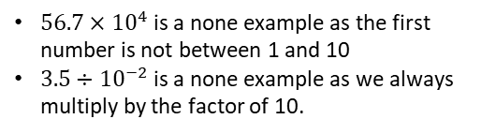
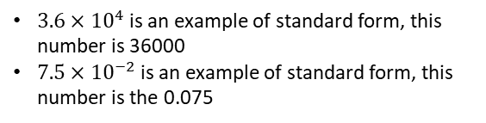
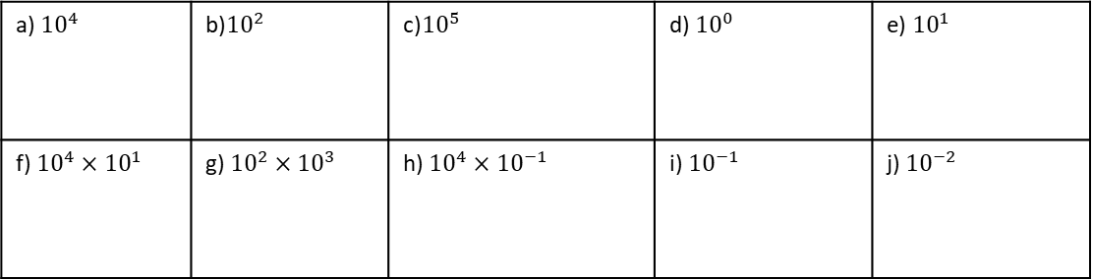
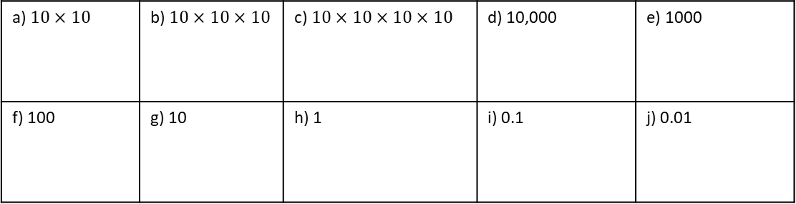

Subtopic 8 (Crossover) – Standard Form
LEARNING OUTCOME: Understand and compare numbers in standard form
Objectives:
Keywords:
Standard form
Indices
Place value
Decimal point
Index Notation
Understand standard form.
Convert numbers to and from standard form.
Definition
Characteristics
Standard form is the way to represent very large of very small numbers. It is used in science to show size of cells or distances in space
Written in the form $A×{10}^{n}$, where A is a number between 1 and 10, and n is a positive or negative integer
Standard form is written with the first number being a number between 1 and 10. This can be a decimal
We then multiply it by a power of 10, either positive or negative. Positive powers represent large numbers, negative powers represent small
4⁶ = 4 × 4 × 4 × 4 × 4 × 4 | six lots of 4 multiplied together
6⁴ = 6 × 6 × 6 × 6 | four lots of 6 multiplied together
7³ = 7 × 7 × 7
Standard Form
Examples
Non - Examples
You can write a million as 1 000 000 = 10⁶.
A number multiplied by itself is the number ‘squared’. You need to know the square numbers (power 2) up to 15² = 225. How many of them can you write down from memory? You will also find it helpful to know the cubes numbers (power 3) up to 6³ = 216
$3.6×{10}^{4}$ is an example of standard form, this number is 36000
$7.5×{10}^{−2}$ is an example of standard form, this number is the 0.075
$56.7×{10}^{4}$ is a none example as the first number is not between 1 and 10
$3.5÷{10}^{−2}$ is a none example as we always multiply by the factor of 10.
KNOWLEDGE CHECK
1. Write each of the following as a power of 10.
a) $10×10$ | b) $10×10×10$ | c) $10×10×10×10$ | d) 10,000 | e) 1000
f) 100 | g) 10 | h) 1 | i) 0.1 | j) 0.01
2. Write each of the following as ordinary number.
a) ${10}^{4}$ | b)${10}^{2}$ | c)${10}^{5}$ | d) ${10}^{0}$ | e) ${10}^{1}$
f) ${10}^{4}×{10}^{1}$ | g) ${10}^{2}×{10}^{3}$ | h) ${10}^{4}×{10}^{−1}$ | i) ${10}^{−1}$ | j) ${10}^{−2}$

Slide 2
Example 1 - I do…
Example 2– We do…
Example 3 – You do…
Steps | Write in standard form.
1) Set the first digit to be between 1 and 10. | a) 500 | a) 300 | 800
 | b) 5000 | b) 50,000 | b) 2000
2) Show how many times you must multiply by 10 to represent the number
 | c) 5,000,000 | c) 6000 | c) 900,000
INDEPENDENT PRACTICE
3. Write each of the following in standard form.
20 | b) 30 | c) 70 | d) 100
e) 200 | f) 2000 | g) 400 | h) Seven hundred
900 | j) 1000 | k) 40 000 | l) Sixty thousand
m) 90 million | n) Four hundred | o) 10 | p) 1

Slide 3
Example 4 - I do…
Example 5– We do…
Example 6 – You do…
Steps | Write in standard form.
1) Set the first digit to be between 1 and 10. | a) 120 | a) 360 | 820
 | b) 1200 | b) 48000 | b) 4500
2) Show many times you must multiply by 10 to represent the number
 | c) 12300 | c) 148000 | c) 12700
INDEPENDENT PRACTICE
4. Write each of the following in standard form.
350 | b) 3500 | c) 35300 | d) 53300
e) 355 000 | f) 530 000 | g) 35 million | h) 5300
i) 3300 | j) 55 000 | k) One hundred and thirty five thousand. | l) 350 000 000
m) 20 200 | n) 202 230 | o) 2023 | p) 20 300

Slide 4
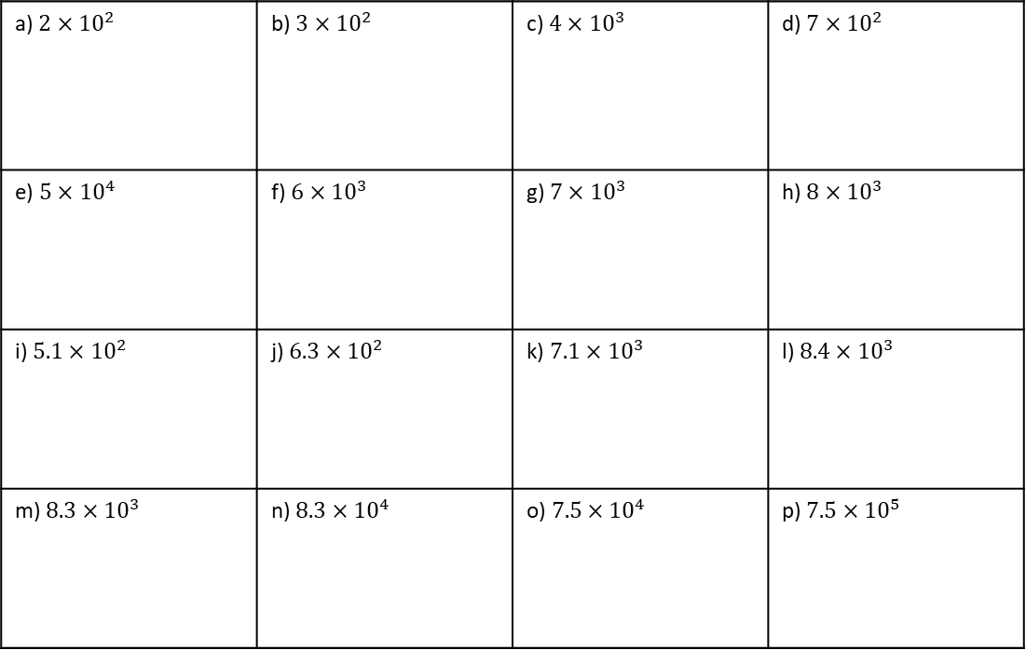
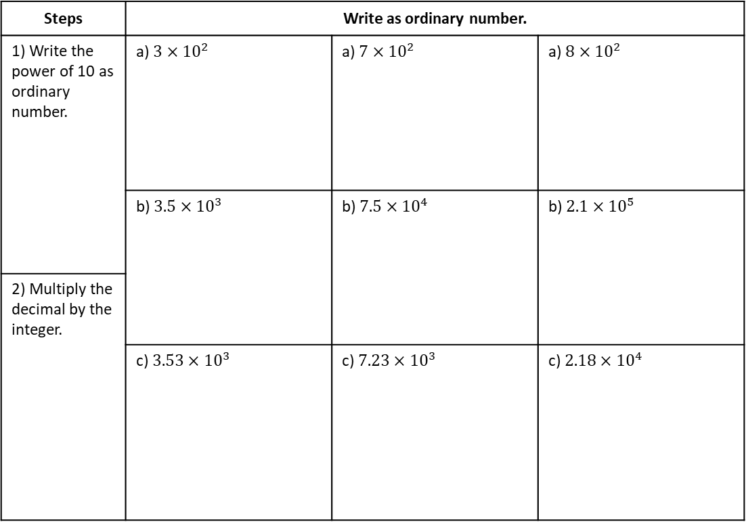
Example 7- I do…
Example 8– We do…
Example 9 – You do…
Steps | Write as ordinary number. | Write as an ordinary number | Write as an ordinary number
1) Write the power of 10 as ordinary number. | a) $3×{10}^{2}$ | a) $7×{10}^{2}$ | a) $8×{10}^{2}$
 | b) $3.5×{10}^{3}$ | b) $7.5×{10}^{4}$ | b) $2.1×{10}^{5}$
2) Multiply the decimal by the integer.
 | c) $3.53×{10}^{3}$ | c) $7.23×{10}^{3}$ | c) $2.18×{10}^{4}$
INDEPENDENT PRACTICE
5. Write each of the following as an ordinary number.
a) $2×{10}^{2}$ | b) $3×{10}^{2}$ | c) $4×{10}^{3}$ | d) $7×{10}^{2}$
e) $5×{10}^{4}$ | f) $6×{10}^{3}$ | g) $7×{10}^{3}$ | h) $8×{10}^{3}$
i) $5.1×{10}^{2}$ | j) $6.3×{10}^{2}$ | k) $7.1×{10}^{3}$ | l) $8.4×{10}^{3}$
m) $8.3×{10}^{3}$ | n) $8.3×{10}^{4}$ | o) $7.5×{10}^{4}$ | p) $7.5×{10}^{5}$

Slide 5
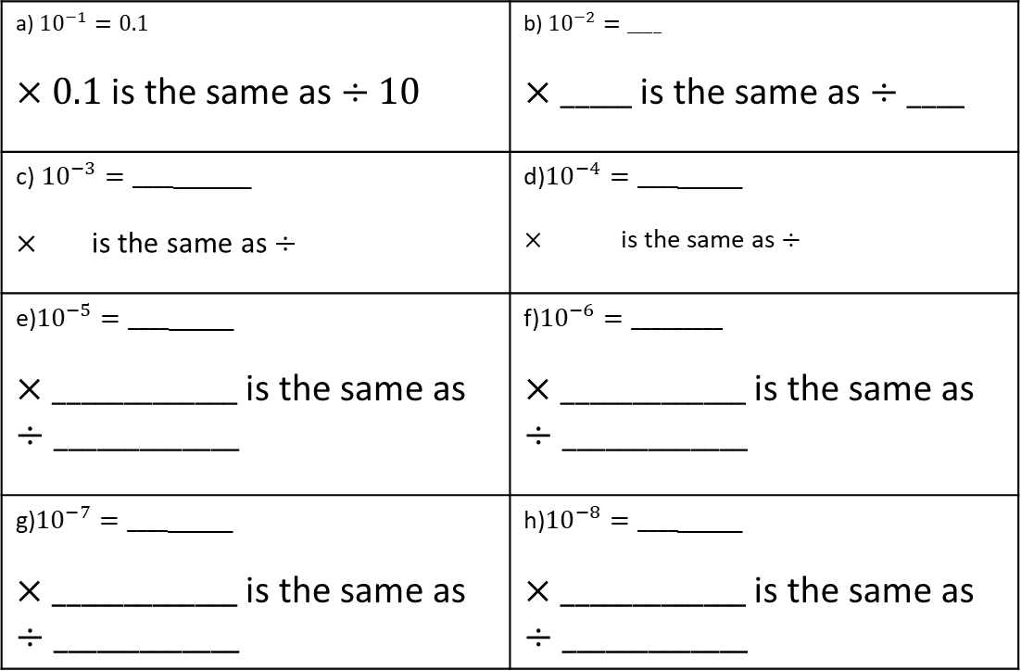
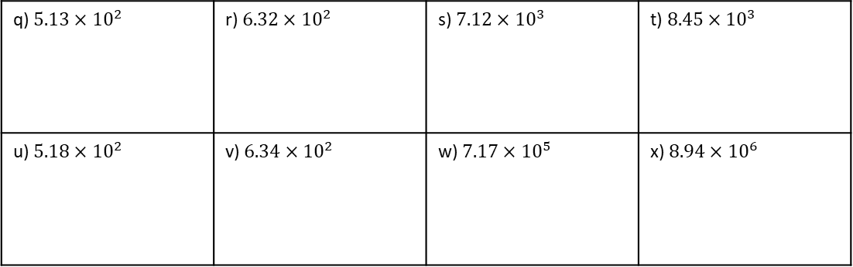
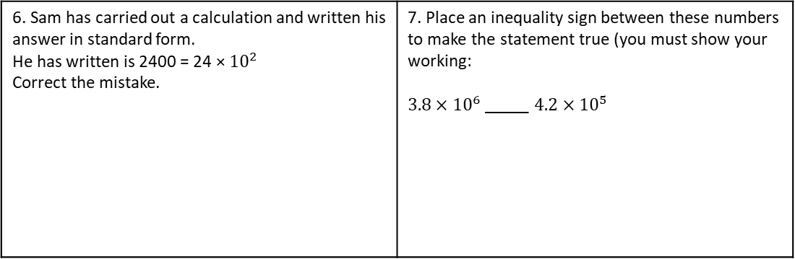
q) $5.13×{10}^{2}$ | r) $6.32×{10}^{2}$ | s) $7.12×{10}^{3}$ | t) $8.45×{10}^{3}$
u) $5.18×{10}^{2}$ | v) $6.34×{10}^{2}$ | w) $7.17×{10}^{5}$ | x) $8.94×{10}^{6}$
6. Sam has carried out a calculation and written his answer in standard form. He has written is 2400 = 24 × ${10}^{2}$ Correct the mistake. | 7. Place an inequality sign between these numbers to make the statement true (you must show your working: $3.8×{10}^{6}$ _____ $4.2×{10}^{5}$
KNOWLEDGE CHECK
8. Fill in the gaps. The first one has been done for you.
a) ${10}^{−1}=0.1$ $×0.1$ is the same as $÷10$ | b) ${10}^{−2}=____$ $×_____$ is the same as $÷____$
c) ${10}^{−3}=____$______ $×$is the same as $÷$ | d)${10}^{−4}=____$_____ $×$is the same as $÷$
e)${10}^{−5}=____$_____ $×_____________$ is the same as $÷_____________$ | f)${10}^{−6}=_________$ $×_____________$ is the same as $÷_____________$
g)${10}^{−7}=____$_____ $×_____________$ is the same as $÷_____________$ | h)${10}^{−8}=____$_____ $×_____________$ is the same as $÷_____________$

Slide 6
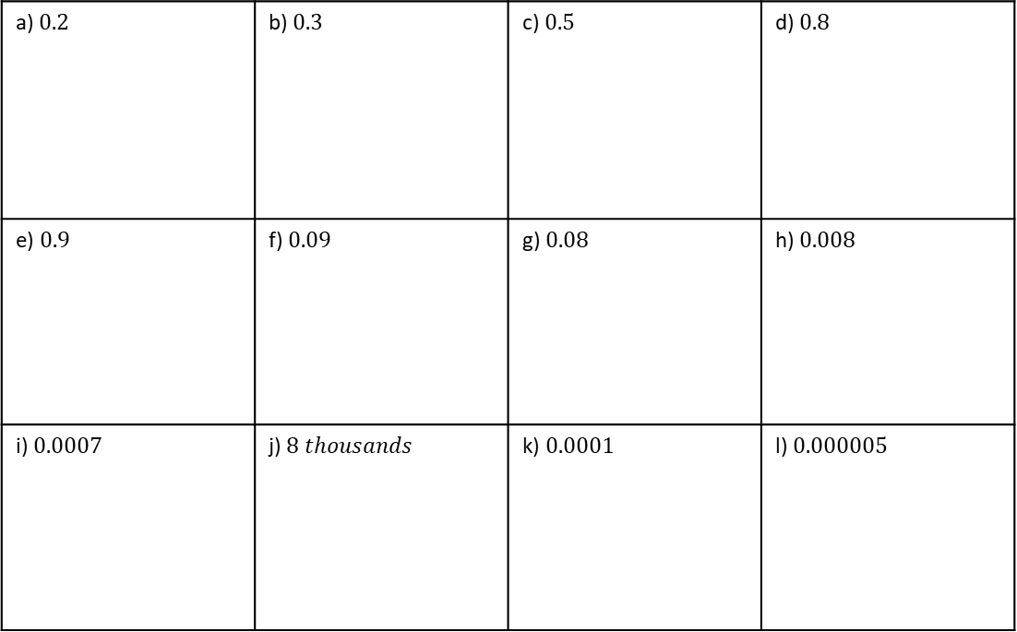
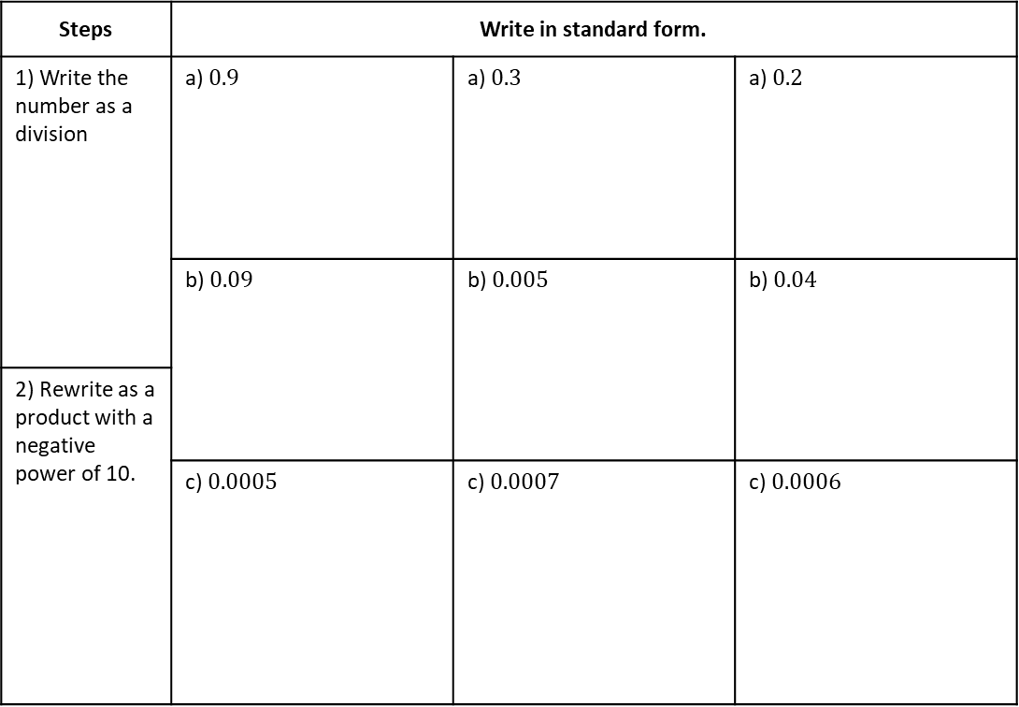
Example 10 - I do…
Example 11– We do…
Example 12 – You do…
Steps | Write in standard form.
1) Write the number as a division | a) $0.9$ | a) $0.3$ | a) $0.2$
 | b) $0.09$ | b) $0.005$ | b) $0.04$
2) Rewrite as a product with a negative power of 10.
 | c) $0.0005$ | c) $0.0007$ | c) $0.0006$
INDEPENDENT PRACTICE
9. Write the following numbers in standard form:
a) $0.2$ | b) $0.3$ | c) $0.5$ | d) $0.8$
e) $0.9$ | f) $0.09$ | g) $0.08$ | h) $0.008$
i) $0.0007$ | j) $8 thousands$ | k) $0.0001$ | l) $0.000005$

Slide 7
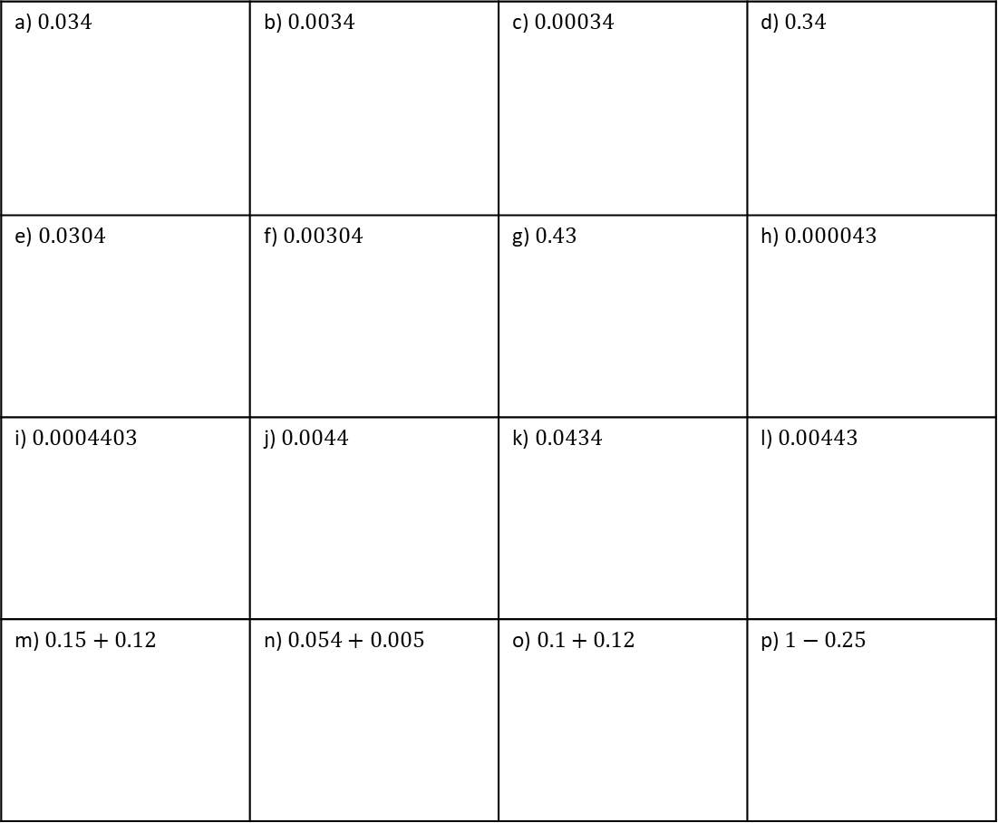
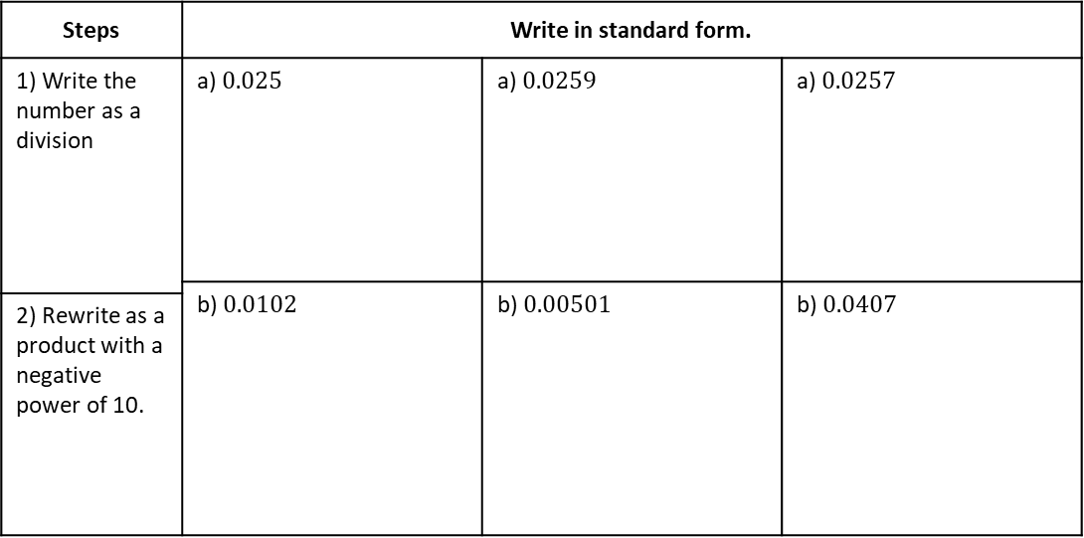
Example 13 - I do…
Example 14– We do…
Example 15 – You do…
Steps | Write in standard form.
1) Write the number as a division | a) $0.025$ | a) $0.0259$ | a) $0.0257$
 | b) $0.0102$ | b) $0.00501$ | b) $0.0407$
2) Rewrite as a product with a negative power of 10.
INDEPENDENT PRACTICE
10. Write the following numbers in standard form.
a) $0.034$ | b) $0.0034$ | c) $0.00034$ | d) $0.34$
e) $0.0304$ | f) $0.00304$ | g) $0.43$ | h) $0.000043$
i) $0.0004403$ | j) $0.0044$ | k) $0.0434$ | l) $0.00443$
m) $0.15+0.12$ | n) $0.054+0.005$ | o) $0.1+0.12$ | p) $1−0.25$

Slide 8
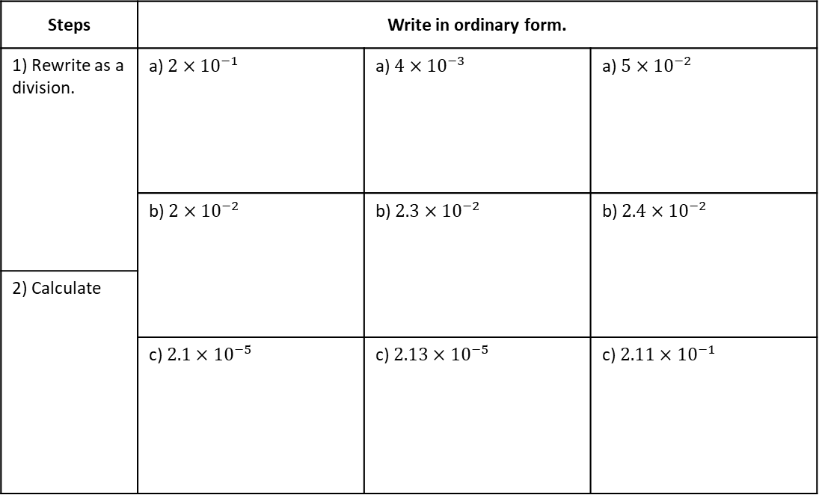
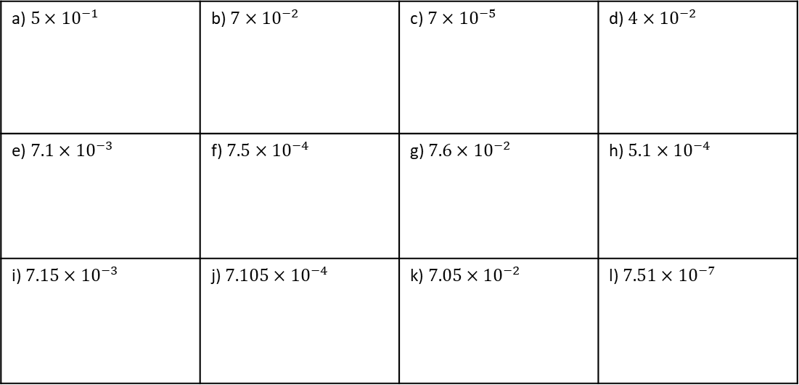
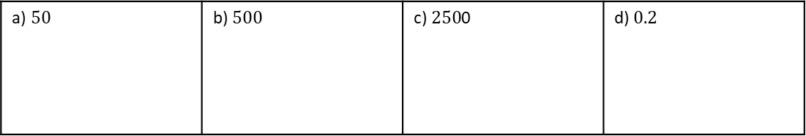
Example 16 - I do…
Example 17– We do…
Example 18 – You do…
Steps | Write in ordinary form.
1) Rewrite as a division. | a) $2×{10}^{−1}$ | a) $4×{10}^{−3}$ | a) $5×{10}^{−2}$
 | b) $2×{10}^{−2}$ | b) $2.3×{10}^{−2}$ | b) $2.4×{10}^{−2}$
2) Calculate
 | c) $2.1×{10}^{−5}$ | c) $2.13×{10}^{−5}$ | c) $2.11×{10}^{−1}$
INDEPENDENT PRACTICE
11. Write the following numbers in ordinary form.
a)$5×{10}^{−1}$ | b) $7×{10}^{−2}$ | c) $7×{10}^{−5}$ | d) $4×{10}^{−2}$
e) $7.1×{10}^{−3}$ | f) $7.5×{10}^{−4}$ | g) $7.6×{10}^{−2}$ | h) $5.1×{10}^{−4}$
i) $7.15×{10}^{−3}$ | j) $7.105×{10}^{−4}$ | k) $7.05×{10}^{−2}$ | l) $7.51×{10}^{−7}$
12. Write the following numbers in standard form.
a)$50$ | b) $500$ | c) $250$0 | d) $0.2$

Slide 9



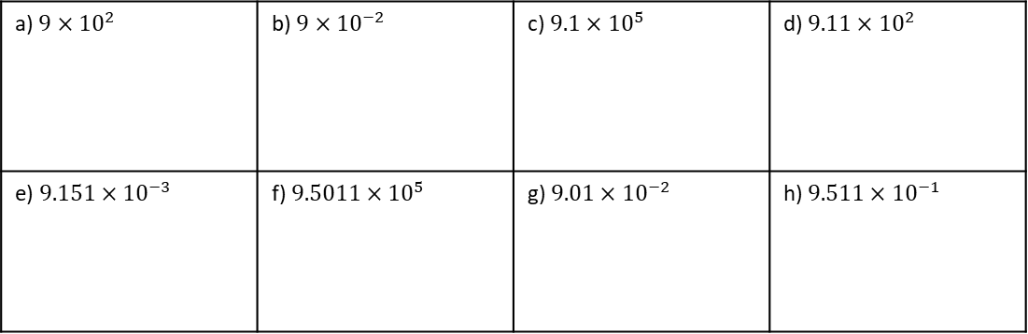


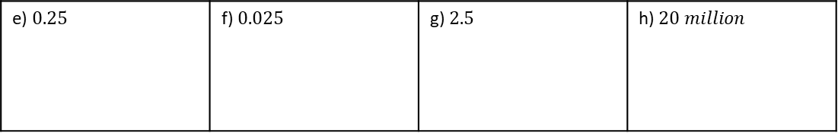

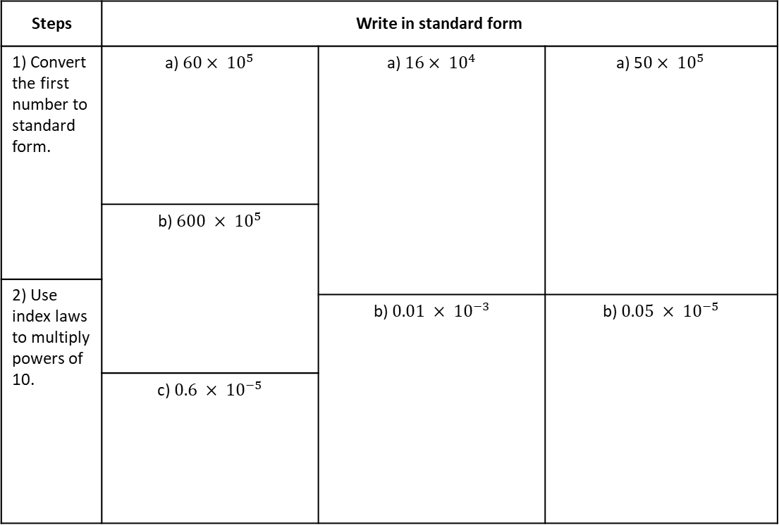
e) $0.25$ | f) $0.025$ | g) $2.5$ | h) $20 million$
13. Write the following numbers in ordinary form.
a) $9×{10}^{2}$ | b) $9×{10}^{−2}$ | c) $9.1×{10}^{5}$ | d) $9.11×{10}^{2}$
e) $9.151×{10}^{−3}$ | f) $9.5011×{10}^{5}$ | g) $9.01×{10}^{−2}$ | h) $9.511×{10}^{−1}$
14. Which of the following are written in correct standard form? Tick all that apply.
a) $1.6 × {10}^{4}$
b) $60×{10}^{−4}$
c) $1.16×{10}^{0.4}$
d) $16×{10}^{−4}$
e) $1.06 ×{10}^{−4}$
f) $0.16 × {10}^{−4}$
Example 19 - I do…
Example 20- We do…
Example 21 - You do…
Steps | Write in standard form
1) Convert the first number to standard form. | a) $60× {10}^{5}$ | a) $16× {10}^{4}$ | a) 5$0× {10}^{5}$
 | b) $600 × {10}^{5}$
2) Use index laws to multiply powers of 10.
 |  | b) $0.01 × {10}^{−3}$ | b) $0.05 × {10}^{−5}$
 | c) $0.6 × {10}^{−5}$

Slide 10
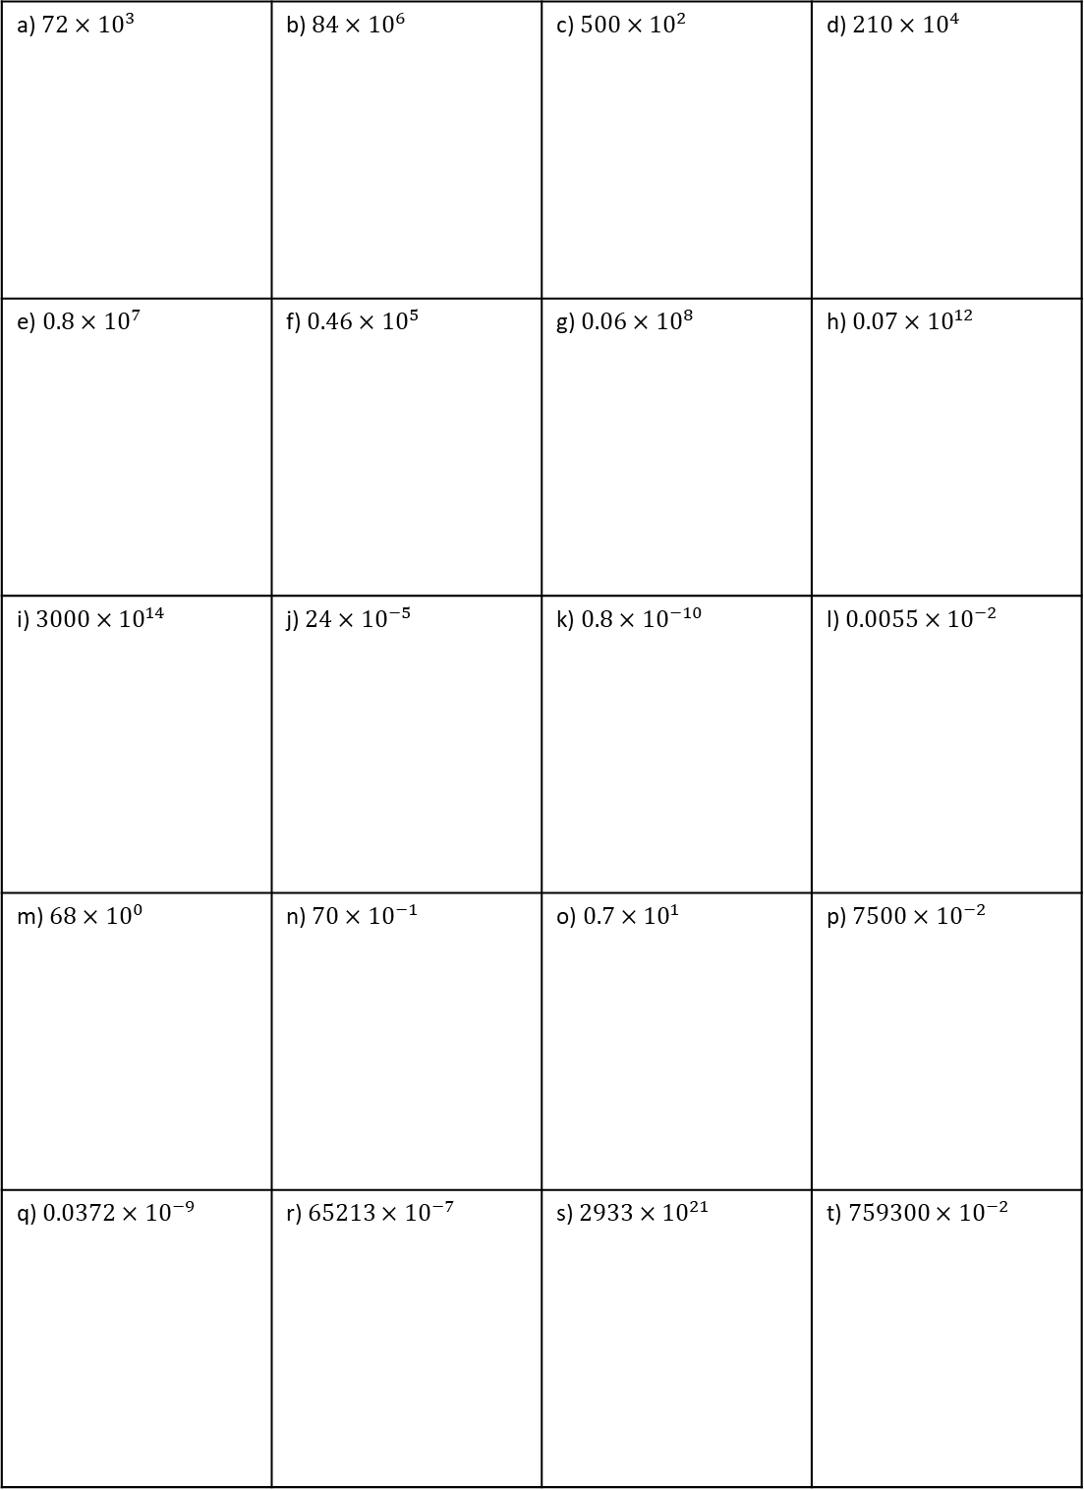
INDEPENDENT PRACTICE
15. Correct these into standard form.
a) $72×{10}^{3}$ | b) $84×{10}^{6}$ | c) $500×{10}^{2}$ | d) $210×{10}^{4}$
e) $0.8×{10}^{7}$ | f) $0.46×{10}^{5}$ | g) $0.06×{10}^{8}$ | h) $0.07×{10}^{12}$
i) $3000×{10}^{14}$ | j) $24×{10}^{−5}$ | k) $0.8×{10}^{−10}$ | l) $0.0055×{10}^{−2}$
m) $68×{10}^{0}$ | n) $70×{10}^{−1}$ | o) $0.7×{10}^{1}$ | p) $7500×{10}^{−2}$
q) $0.0372×{10}^{−9}$ | r) $65213×{10}^{−7}$ | s) $2933×{10}^{21}$ | t) $759300×{10}^{−2}$

Slide 11
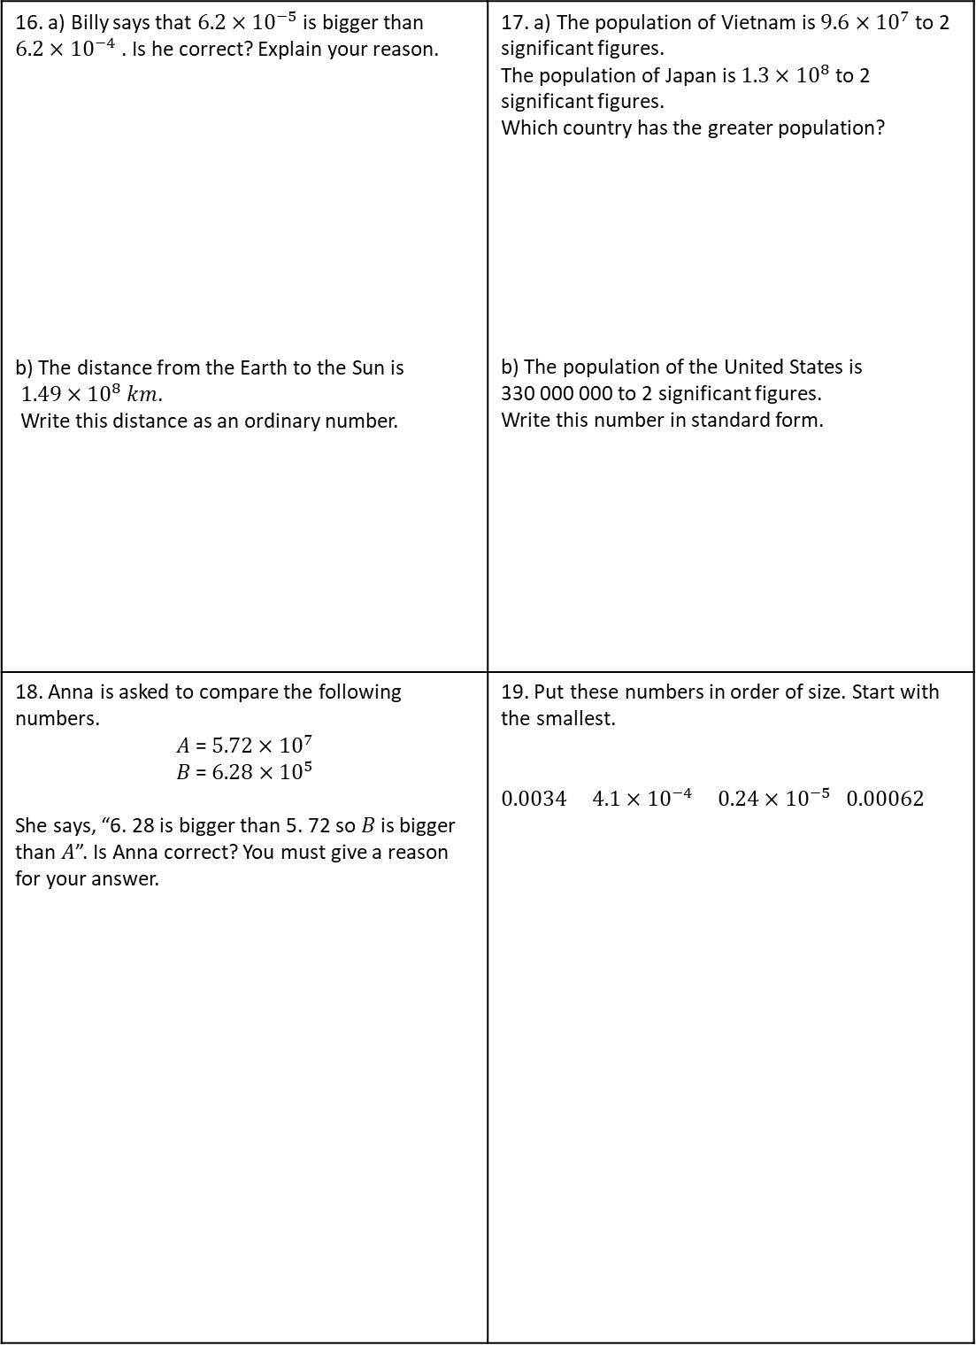
MIXED PRACTICE
16. a) Billy says that $6.2×{10}^{−5}$ is bigger than $6.2×{10}^{−4}$ . Is he correct? Explain your reason. b) The distance from the Earth to the Sun is $1.49×{10}^{8}$ 𝑘𝑚. Write this distance as an ordinary number. | 17. a) The population of Vietnam is $9.6×{10}^{7}$ to 2 significant figures. The population of Japan is $1.3×{10}^{8}$ to 2 significant figures. Which country has the greater population? b) The population of the United States is 330 000 000 to 2 significant figures. Write this number in standard form.
18. Anna is asked to compare the following numbers. 𝐴 = $5.72×{10}^{7}$ 𝐵 = $6.28×{10}^{5}$ She says, “6. 28 is bigger than 5. 72 so 𝐵 is bigger than 𝐴”. Is Anna correct? You must give a reason for your answer. | 19. Put these numbers in order of size. Start with the smallest. $0.0034$ $4.1×{10}^{−4}$ $0.24×{10}^{−5}$ $0.00062$

Slide 12
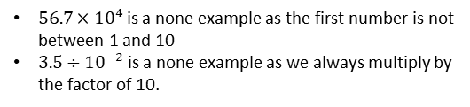
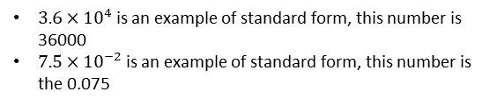
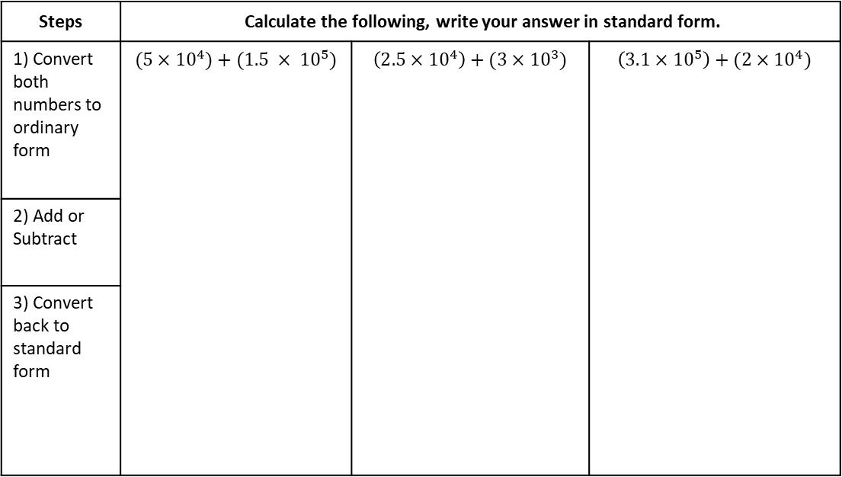

Subtopic 8b – The Four Operations with Standard Form
LEARNING OUTCOME: Perform four operations in standard form.
Objectives:
Keywords:
Standard form
Indices
Place value
Decimal point
Index Notation
Calculate using numbers in standard form.
Apply to problem solving questions.
Definition
Characteristics
Standard form is the way to represent very large of very small numbers. It is used in science to show size of cells or distances in space
Written in the form $A×{10}^{n}$, where A is a number between 1 and 10, and n is a positive or negative integer
Standard form is written with the first number being a number between 1 and 10. This can be a decimal
We then multiply it by a power of 10, either positive or negative. Positive powers represent large numbers, negative powers represent small
4⁶ = 4 × 4 × 4 × 4 × 4 × 4 | six lots of 4 multiplied together
6⁴ = 6 × 6 × 6 × 6 | four lots of 6 multiplied together
7³ = 7 × 7 × 7
Standard Form
Examples
Non - Examples
You can write a million as 1 000 000 = 10⁶.
A number multiplied by itself is the number ‘squared’. You need to know the square numbers (power 2) up to 15² = 225. How many of them can you write down from memory? You will also find it helpful to know the cubes numbers (power 3) up to 6³ = 216
$3.6×{10}^{4}$ is an example of standard form, this number is 36000
$7.5×{10}^{−2}$ is an example of standard form, this number is the 0.075
$56.7×{10}^{4}$ is a none example as the first number is not between 1 and 10
$3.5÷{10}^{−2}$ is a none example as we always multiply by the factor of 10.
Adding and Subtracting
Example 1 - I do…
Example 2 – We do…
Example 3 – You do…
Calculate $\left(2×{10}^{6}\right)−(8×{10}^{5})$
Steps | Calculate the following, write your answer in standard form.
1) Convert both numbers to ordinary form | $$(5×{10}^{4})+(1.5 × {10}^{5})$$ | $$\left(2.5×{10}^{4}\right)+(3×{10}^{3})$$ | $$\left(3.1×{10}^{5}\right)+(2×{10}^{4})$$
2) Add or Subtract
3) Convert back to standard form

Slide 13
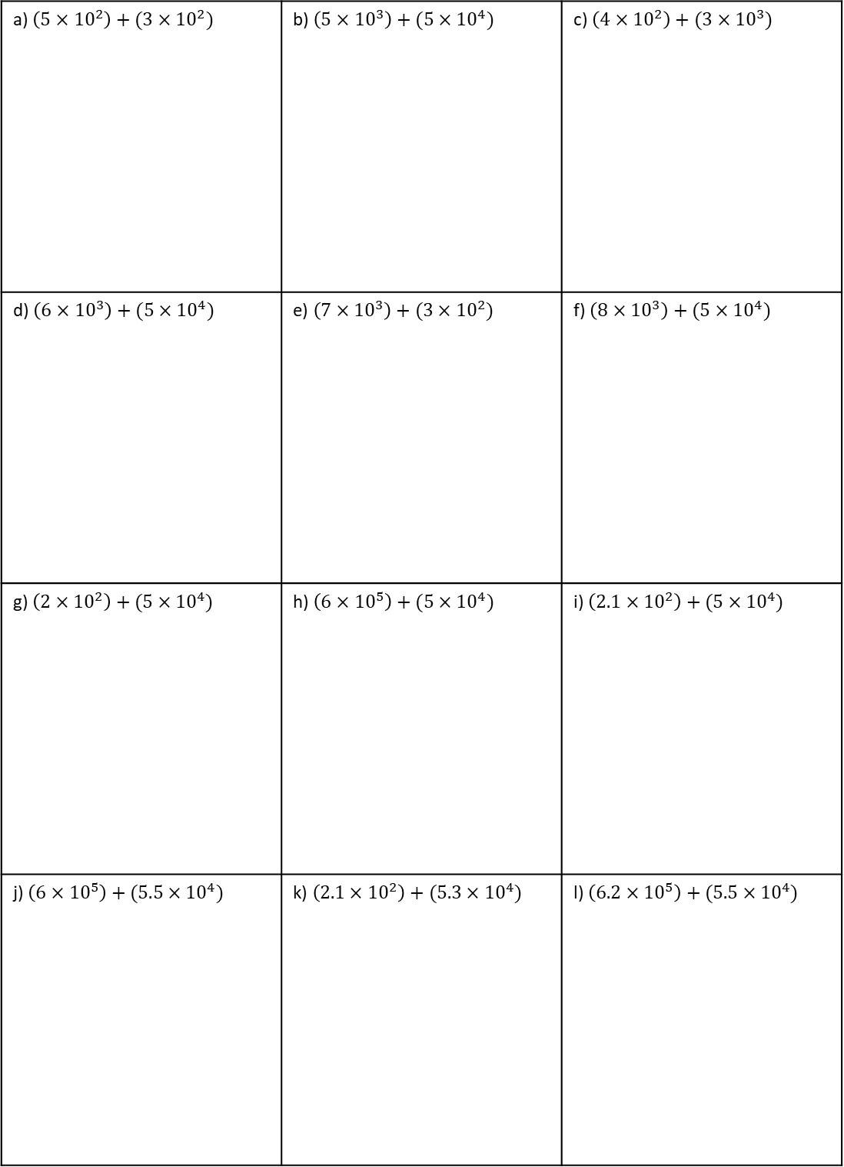
INDEPENDENT PRACTICE
1. Calculate the following, give your answers in standard form.
a) $\left(5×{10}^{2}\right)+(3×{10}^{2})$ | b) $\left(5×{10}^{3}\right)+(5×{10}^{4})$ | c) $\left(4×{10}^{2}\right)+(3×{10}^{3})$
d) $\left(6×{10}^{3}\right)+(5×{10}^{4})$ | e) $\left(7×{10}^{3}\right)+(3×{10}^{2})$ | f) $\left(8×{10}^{3}\right)+(5×{10}^{4})$
g) $\left(2×{10}^{2}\right)+(5×{10}^{4})$ | h) $\left(6×{10}^{5}\right)+(5×{10}^{4})$ | i) $\left(2.1×{10}^{2}\right)+(5×{10}^{4})$
j) $\left(6×{10}^{5}\right)+(5.5×{10}^{4})$ | k) $\left(2.1×{10}^{2}\right)+(5.3×{10}^{4})$ | l) $\left(6.2×{10}^{5}\right)+(5.5×{10}^{4})$

Slide 14
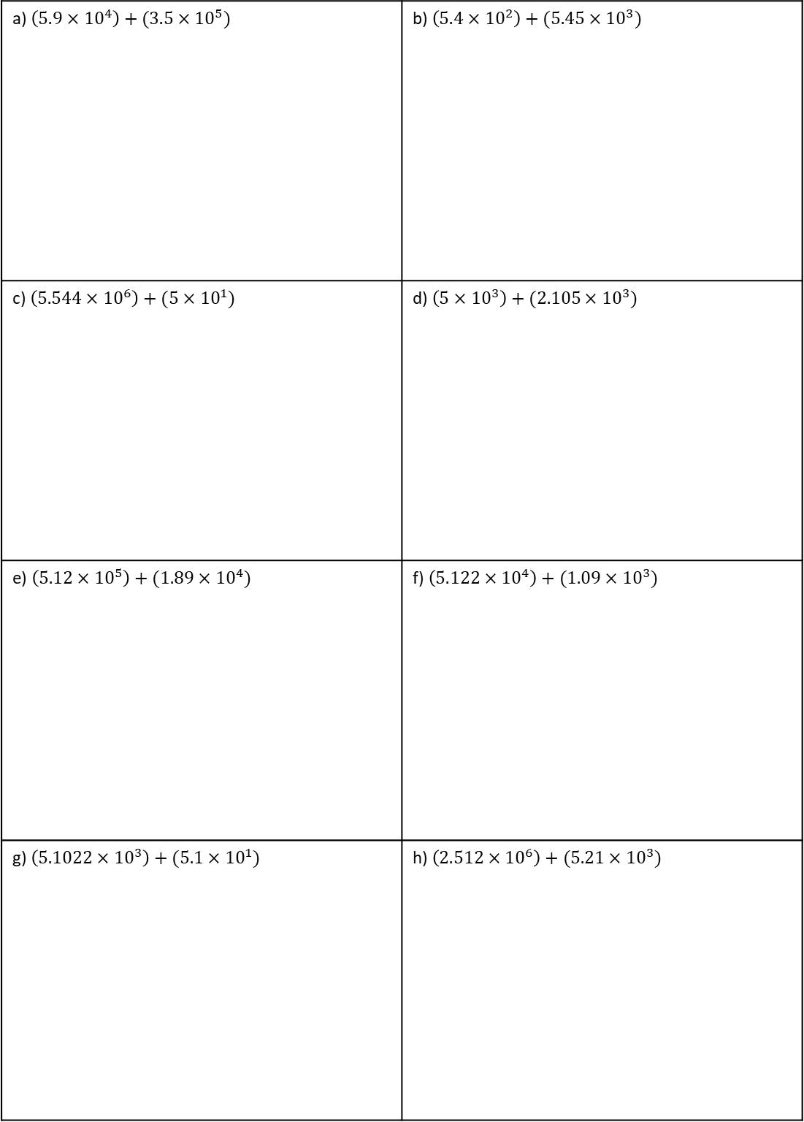
2. Calculate the following, give your answers in standard form.
a) $\left(5.9×{10}^{4}\right)+(3.5×{10}^{5})$ | b) $\left(5.4×{10}^{2}\right)+(5.45×{10}^{3})$
c) $\left(5.544×{10}^{6}\right)+(5×{10}^{1})$ | d) $\left(5×{10}^{3}\right)+(2.105×{10}^{3})$
e) $\left(5.12×{10}^{5}\right)+(1.89×{10}^{4})$ | f) $\left(5.122×{10}^{4}\right)+(1.09×{10}^{3})$
g) $\left(5.1022×{10}^{3}\right)+(5.1×{10}^{1})$ | h) $\left(2.512×{10}^{6}\right)+(5.21×{10}^{3})$

Slide 15
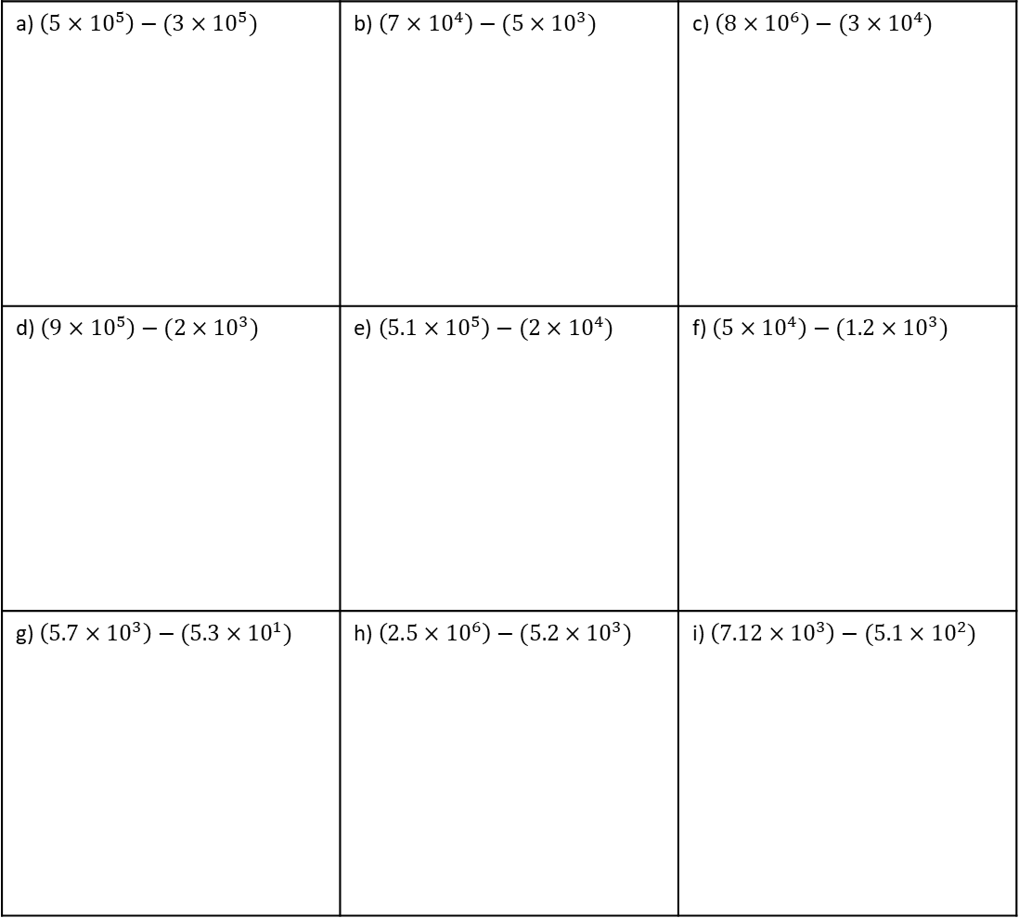
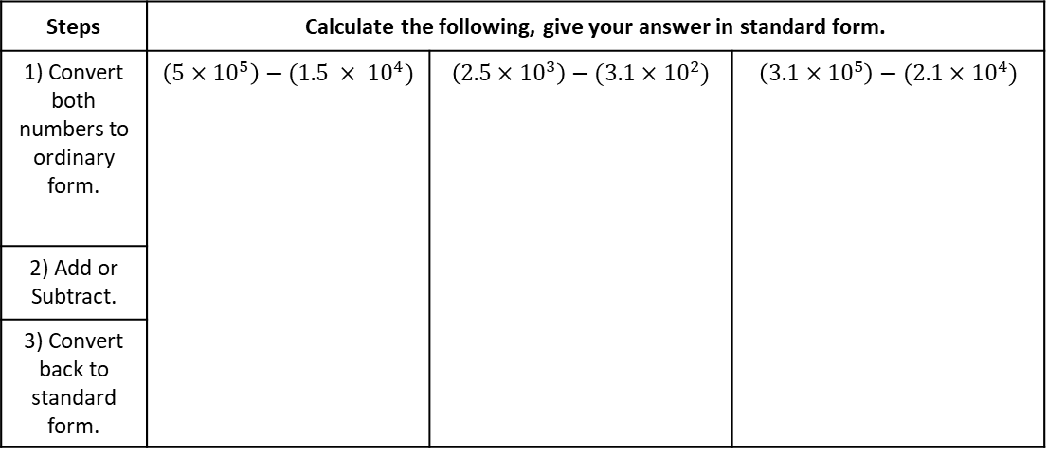
Example 4 - I do…
Example 5 – We do…
Example 6 – You do…
Calculate $\left(2.4×{10}^{4}\right)+(1.6×{10}^{2})$
Steps | Calculate the following, give your answer in standard form.
1) Convert both numbers to ordinary form. | $$\left(5×{10}^{5}\right)−(1.5 × {10}^{4})$$ | $$\left(2.5×{10}^{3}\right)−(3.1×{10}^{2})$$ | $$\left(3.1×{10}^{5}\right)−(2.1×{10}^{4})$$
2) Add or Subtract.
3) Convert back to standard form.
INDEPENDENT PRACTICE
3. Calculate the following, give your answers in standard form.
a) $\left(5×{10}^{5}\right)−(3×{10}^{5})$ | b) $\left(7×{10}^{4}\right)−(5×{10}^{3})$ | c) $\left(8×{10}^{6}\right)−(3×{10}^{4})$
d) $\left(9×{10}^{5}\right)−(2×{10}^{3})$ | e) $\left(5.1×{10}^{5}\right)−(2×{10}^{4})$ | f) $\left(5×{10}^{4}\right)−(1.2×{10}^{3})$
g) $\left(5.7×{10}^{3}\right)−(5.3×{10}^{1})$ | h) $\left(2.5×{10}^{6}\right)−(5.2×{10}^{3})$ | i) $\left(7.12×{10}^{3}\right)−(5.1×{10}^{2})$

Slide 16
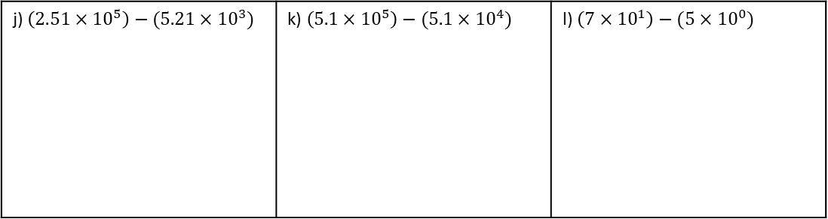
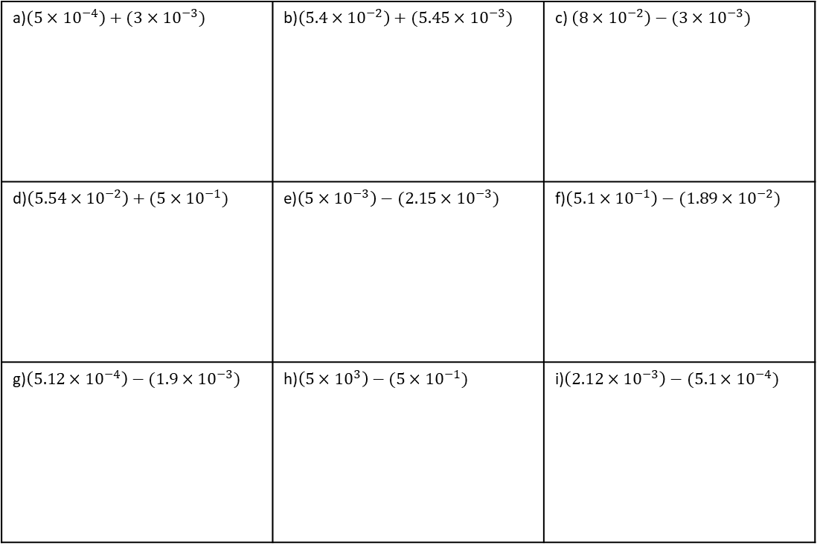
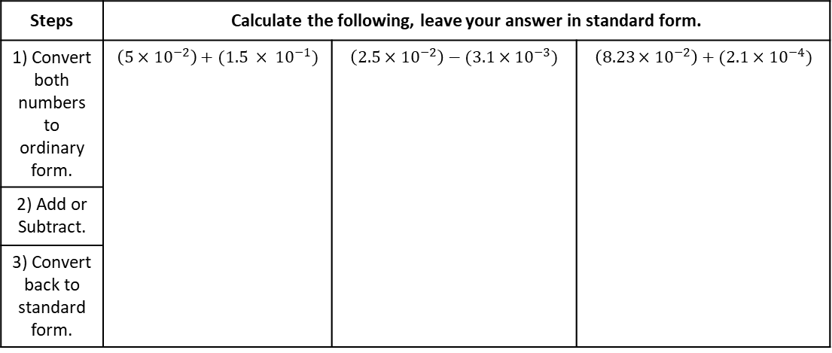
j) $\left(2.51×{10}^{5}\right)−(5.21×{10}^{3})$ | k) $\left(5.1×{10}^{5}\right)−(5.1×{10}^{4})$ | l) $\left(7×{10}^{1}\right)−(5×{10}^{0})$
Example 7 - I do…
Example 8 – We do…
Example 9 – You do…
Calculate $\left(2.4×{10}^{4}\right)+(1.6×{10}^{2})$
Steps | Calculate the following, leave your answer in standard form.
1) Convert both numbers to ordinary form. | $$\left(5×{10}^{−2}\right)+(1.5 × {10}^{−1})$$ | $$\left(2.5×{10}^{−2}\right)−(3.1×{10}^{−3})$$ | $$\left(8.23×{10}^{−2}\right)+(2.1×{10}^{−4})$$
2) Add or Subtract.
3) Convert back to standard form.
INDEPENDENT PRACTICE
4. Calculate the following, give your answers in standard form.
a)$\left(5×{10}^{−4}\right)+(3×{10}^{−3})$ | b)$\left(5.4×{10}^{−2}\right)+(5.45×{10}^{−3})$ | c) $\left(8×{10}^{−2}\right)−(3×{10}^{−3})$
d)$\left(5.54×{10}^{−2}\right)+(5×{10}^{−1})$ | e)$\left(5×{10}^{−3}\right)−(2.15×{10}^{−3})$ | f)$\left(5.1×{10}^{−1}\right)−(1.89×{10}^{−2})$
g)$\left(5.12×{10}^{−4}\right)−(1.9×{10}^{−3})$ | h)$\left(5×{10}^{3}\right)−(5×{10}^{−1})$ | i)$\left(2.12×{10}^{−3}\right)−(5.1×{10}^{−4})$
Notes:
7

Slide 17
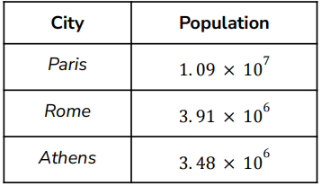
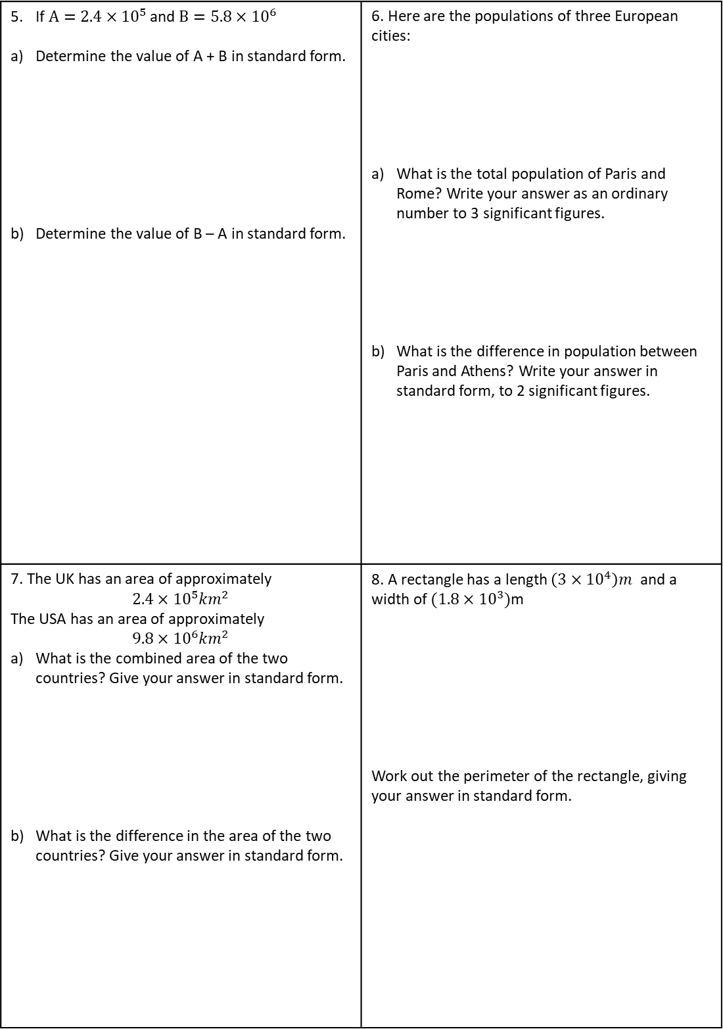


If $A=2.4×{10}^{5}$ and $B=5.8×{10}^{6}$ Determine the value of A + B in standard form. Determine the value of B – A in standard form. | 6. Here are the populations of three European cities: What is the total population of Paris and Rome? Write your answer as an ordinary number to 3 significant figures. What is the difference in population between Paris and Athens? Write your answer in standard form, to 2 significant figures.
7. The UK has an area of approximately $$2.4×{10}^{5}{km}^{2}$$ The USA has an area of approximately $$9.8×{10}^{6}{km}^{2}$$ What is the combined area of the two countries? Give your answer in standard form. What is the difference in the area of the two countries? Give your answer in standard form. | 8. A rectangle has a length $\left(3×{10}^{4}\right)m$ and a width of $(1.8×{10}^{3})$m Work out the perimeter of the rectangle, giving your answer in standard form.
$(1.8×{10}^{3})$m
$(3.6×{10}^{4})$m

Slide 18

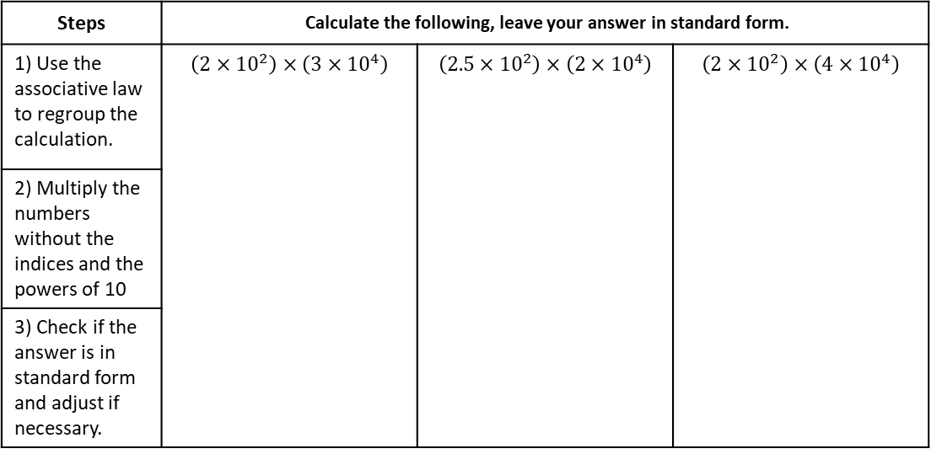








Multiplying and Dividing
Example 10 - I do…
Example 11 – We do…
Example 12 – You do…
Calculate $\left(2.4×{10}^{4}\right)+(1.6×{10}^{2})$
Steps | Calculate the following, leave your answer in standard form.
1) Use the associative law to regroup the calculation. | $$\left(2×{10}^{2}\right)×\left(3×{10}^{4}\right)$$ | $$\left(2.5×{10}^{2}\right)×\left(2×{10}^{4}\right)$$ | $$\left(2×{10}^{2}\right)×\left(4×{10}^{4}\right)$$
2) Multiply the numbers without the indices and the powers of 10
3) Check if the answer is in standard form and adjust if necessary.
INDEPENDENT PRACTICE
9. Calculate the following, give your answers in standard form.
a) $\left(2×{10}^{2}\right)×\left(3×{10}^{4}\right)$
b) $\left(3×{10}^{2}\right)×\left(3×{10}^{4}\right)$
c) $\left(2×{10}^{2}\right)×\left(2×{10}^{4}\right)$
d) $\left(2×{10}^{7}\right)×\left(4×{10}^{4}\right)$
e) $\left(1.5×{10}^{2}\right)×\left(2×{10}^{4}\right)$
f) $\left(2×{10}^{2}\right)×\left(3×{10}^{5}\right)$
d) $\left(2.5×{10}^{8}\right)×\left(2×{10}^{4}\right)$
e) $\left(3.2×{10}^{5}\right)×\left(2×{10}^{6}\right)$
f) $\left(2.8×{10}^{4}\right)×\left(2×{10}^{9}\right)$

Slide 19










Example 13 - I do…
Example 14 – We do…
Example 15 – You do…
Calculate $\left(2.4×{10}^{4}\right)+(1.6×{10}^{2})$
Steps | Calculate the following, leave your answer in standard form.
1) Use the associative law to regroup the calculation. | $$\left(2×{10}^{2}\right)×\left(1.5×{10}^{−4}\right)$$ | $$\left(3×{10}^{−2}\right)×\left(3×{10}^{6}\right)$$ | $$\left(2×{10}^{−3}\right)×\left(4×{10}^{5}\right)$$
2) Multiply the numbers without the indices and the powers of 10
3) Check if the answer is in standard form and adjust if necessary.
INDEPENDENT PRACTICE
10. Calculate the following, give your answers in standard form.
a) $\left(2×{10}^{−2}\right)×\left(3×{10}^{4}\right)$
b) $\left(3×{10}^{−2}\right)×\left(3×{10}^{4}\right)$
c) $\left(2×{10}^{−3}\right)×\left(2×{10}^{7}\right)$
d) $\left(2×{10}^{7}\right)×\left(4×{10}^{−4}\right)$
e) $\left(3×{10}^{2}\right)×\left(3×{10}^{−4}\right)$
f) $\left(2×{10}^{−2}\right)×\left(2×{10}^{−5}\right)$
d) $\left(2×{10}^{−5}\right)×\left(4×{10}^{−3}\right)$
e) $\left(2.1×{10}^{−2}\right)×\left(2×{10}^{−4}\right)$
f) $\left(2.8×{10}^{−2}\right)×\left(3×{10}^{−4}\right)$

Slide 20




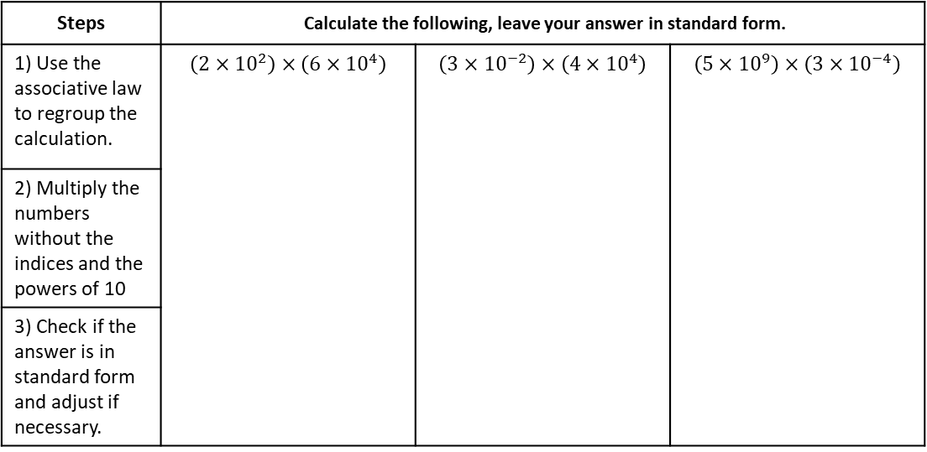























Example 16 - I do…
Example 17 – We do…
Example 18 – You do…
Calculate $\left(2.4×{10}^{4}\right)+(1.6×{10}^{2})$
Steps | Calculate the following, leave your answer in standard form.
1) Use the associative law to regroup the calculation. | $$\left(2×{10}^{2}\right)×\left(6×{10}^{4}\right)$$ | $$\left(3×{10}^{−2}\right)×\left(4×{10}^{4}\right)$$ | $$\left(5×{10}^{9}\right)×\left(3×{10}^{−4}\right)$$
2) Multiply the numbers without the indices and the powers of 10
3) Check if the answer is in standard form and adjust if necessary.
$$1.2×{10}^{7}$$
$$1.2×{10}^{3}$$
$$1.5×{10}^{6}$$
INDEPENDENT PRACTICE
11. Calculate the following, give your answers in standard form.
a) $\left(4×{10}^{2}\right)×\left(3×{10}^{4}\right)$
b) $\left(5×{10}^{4}\right)×\left(2×{10}^{4}\right)$
c) $\left(6×{10}^{6}\right)×\left(2×{10}^{4}\right)$
$$1.2×{10}^{7}$$
$$1×{10}^{9}$$
$$1.2×{10}^{11}$$
d) $\left(2×{10}^{7}\right)×\left(7×{10}^{4}\right)$
e) $\left(7×{10}^{−2}\right)×\left(3×{10}^{4}\right)$
f) $\left(6×{10}^{2}\right)×\left(2×{10}^{−4}\right)$
$$1.4×{10}^{12}$$
$$2.1×{10}^{3}$$
$$1.2×{10}^{−1}$$
g) $\left(3×{10}^{7}\right)×\left(7×{10}^{4}\right)$
h) $\left(8×{10}^{−2}\right)×\left(3×{10}^{5}\right)$
i) $\left(7.5×{10}^{−3}\right)×\left(2×{10}^{4}\right)$
$$2.1×{10}^{12}$$
$$2.4×{10}^{4}$$
$$1.5×{10}^{2}$$
j) $\left(8.3×{10}^{7}\right)×\left(2×{10}^{4}\right)$
k) $\left(9.1×{10}^{−3}\right)×\left(3×{10}^{4}\right)$
l) $\left(8×{10}^{−7}\right)×\left(2.5×{10}^{−4}\right)$
$$1.66×{10}^{12}$$
$$2.73×{10}^{2}$$
$$2×{10}^{−2}$$

Slide 21
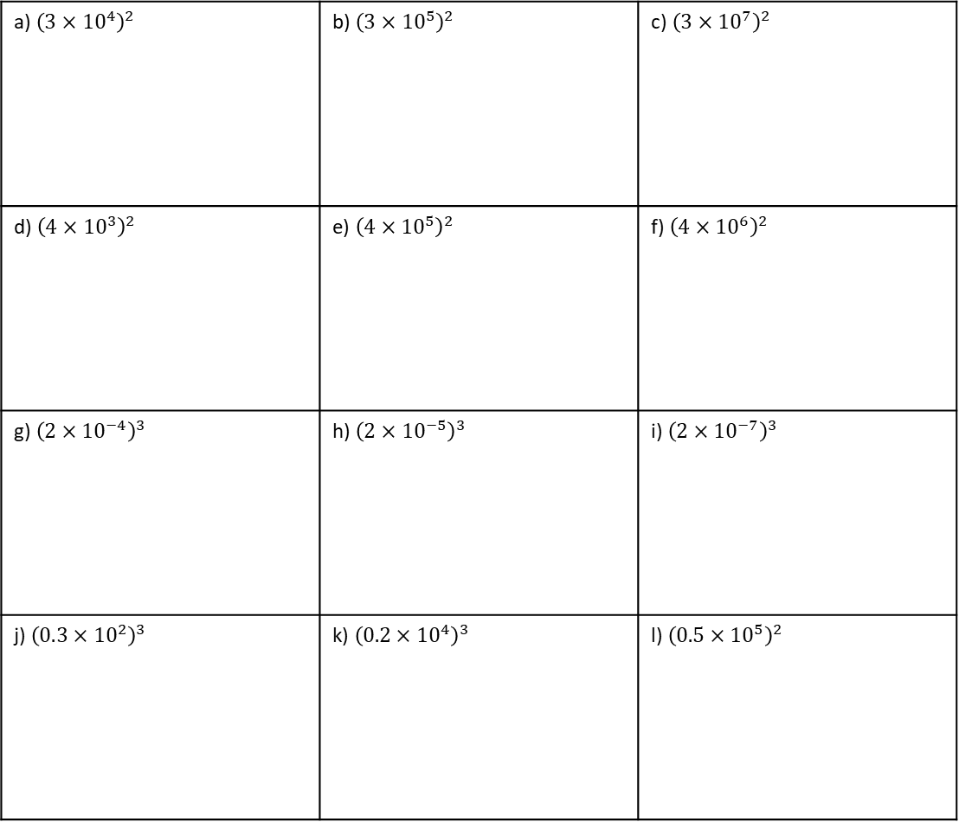
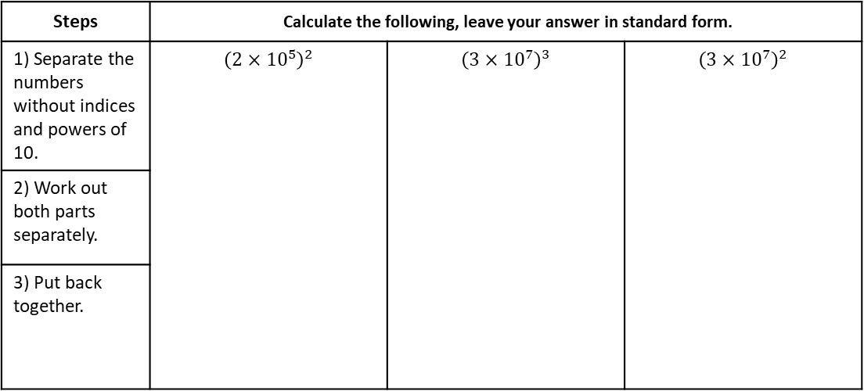
Example 19 - I do…
Example 20 – We do…
Example 21 – You do…
Calculate $\left(2.4×{10}^{4}\right)+(1.6×{10}^{2})$
Steps | Calculate the following, leave your answer in standard form.
1) Separate the numbers without indices and powers of 10. | $${\left(2×{10}^{5}\right)}^{2}$$ | $${\left(3×{10}^{7}\right)}^{3}$$ | $${\left(3×{10}^{7}\right)}^{2}$$
2) Work out both parts separately.
3) Put back together.
INDEPENDENT PRACTICE
12. Calculate the following, give your answers in standard form.
a) ${\left(3×{10}^{4}\right)}^{2}$ | b) ${\left(3×{10}^{5}\right)}^{2}$ | c) ${\left(3×{10}^{7}\right)}^{2}$
d) ${\left(4×{10}^{3}\right)}^{2}$ | e) ${\left(4×{10}^{5}\right)}^{2}$ | f) ${\left(4×{10}^{6}\right)}^{2}$
g) ${\left(2×{10}^{−4}\right)}^{3}$ | h) ${\left(2×{10}^{−5}\right)}^{3}$ | i) ${\left(2×{10}^{−7}\right)}^{3}$
j) ${\left(0.3×{10}^{2}\right)}^{3}$ | k) ${\left(0.2×{10}^{4}\right)}^{3}$ | l) ${\left(0.5×{10}^{5}\right)}^{2}$

Slide 22
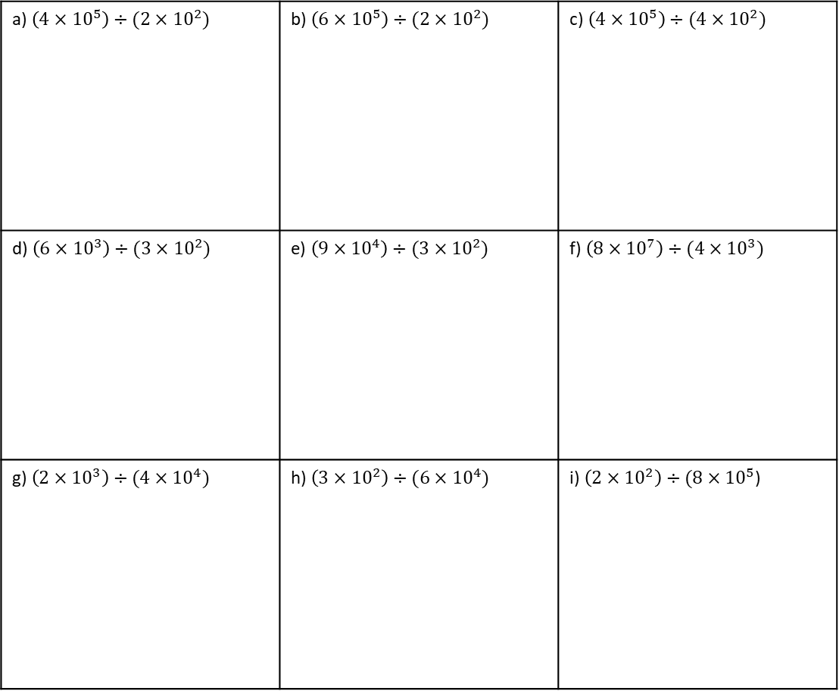

Example 22 - I do…
Example 23 – We do…
Example 24 – You do…
Calculate $\left(2.4×{10}^{4}\right)+(1.6×{10}^{2})$
Calculate $\left(2.4×{10}^{4}\right)+(1.6×{10}^{2})$
Steps | Calculate the following, leave your answer in standard form.
1) Use the associative law to regroup the calculation. | $$\left(8×{10}^{8}\right)÷\left(2×{10}^{4}\right)$$ | $$\left(9×{10}^{4}\right)÷\left(3×{10}^{2}\right)$$ | $$\left(8×{10}^{5}\right)÷\left(4×{10}^{3}\right)$$
2) Divide the numbers without the indices and the powers of 10
3) Check if the answer is in standard form and adjust if necessary.
INDEPENDENT PRACTICE
13. Calculate the following, give your answers in standard form.
a) $\left(4×{10}^{5}\right)÷$ $(2×{10}^{2})$ | b) $\left(6×{10}^{5}\right)÷$ $(2×{10}^{2})$ | c) $\left(4×{10}^{5}\right)÷$ $(4×{10}^{2})$
d) $\left(6×{10}^{3}\right)÷$ $(3×{10}^{2})$ | e) $\left(9×{10}^{4}\right)÷$ $(3×{10}^{2})$ | f) $\left(8×{10}^{7}\right)÷$ $(4×{10}^{3})$
g) $\left(2×{10}^{3}\right)÷$ $(4×{10}^{4})$ | h) $\left(3×{10}^{2}\right)÷$ $(6×{10}^{4})$ | i) $\left(2×{10}^{2}\right)÷$ $(8×{10}^{5}$)

Slide 23

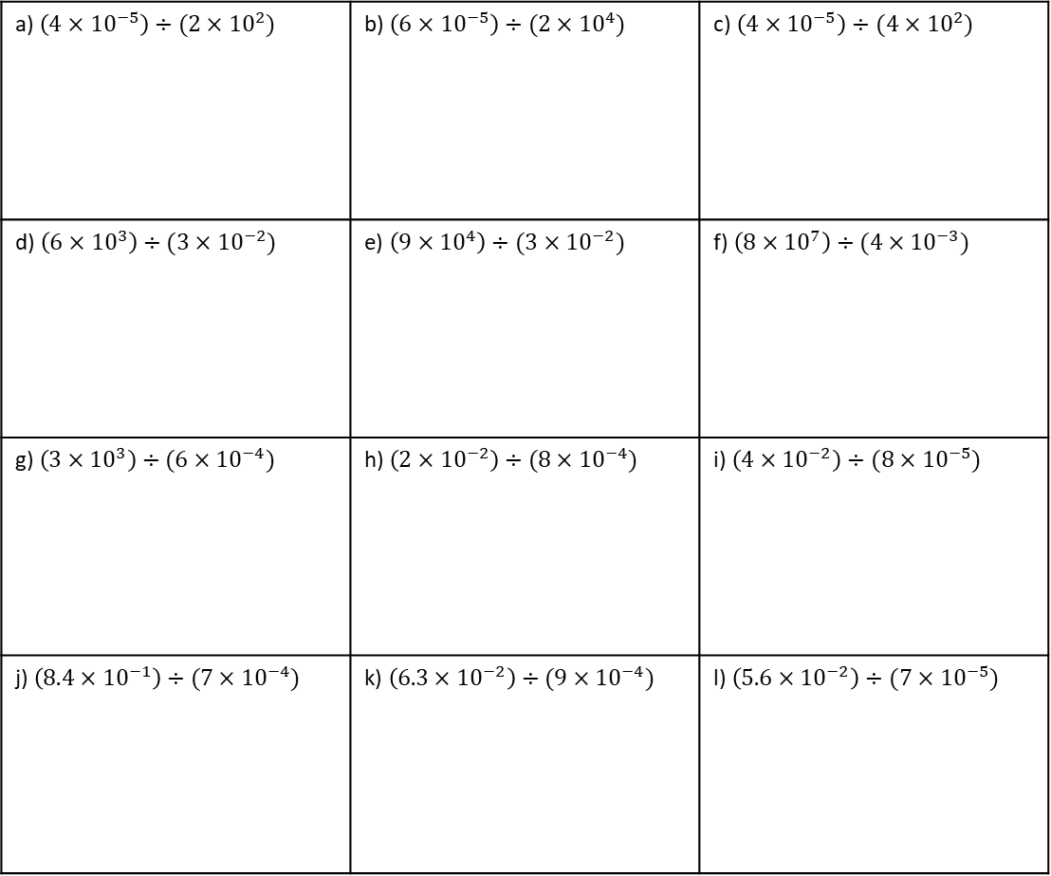
Example 25 - I do…
Example 26 – We do…
Example 27 – You do…
Calculate $\left(2.4×{10}^{4}\right)+(1.6×{10}^{2})$
Steps | Calculate the following, leave your answer in standard form.
1) Use the associative law to regroup the calculation. | $$\left(8×{10}^{−8}\right)÷\left(2×{10}^{4}\right)$$ | $$\left(9×{10}^{4}\right)÷\left(3×{10}^{−2}\right)$$ | $$\left(8×{10}^{−5}\right)÷\left(4×{10}^{3}\right)$$
2) Divide the numbers without the indices and the powers of 10
3) Check if the answer is in standard form and adjust if necessary.
INDEPENDENT PRACTICE
14. Calculate the following, give your answers in standard form.
a) $\left(4×{10}^{−5}\right)÷$ $(2×{10}^{2})$ | b) $\left(6×{10}^{−5}\right)÷$ $(2×{10}^{4})$ | c) $\left(4×{10}^{−5}\right)÷$ $(4×{10}^{2})$
d) $\left(6×{10}^{3}\right)÷$ $(3×{10}^{−2})$ | e) $\left(9×{10}^{4}\right)÷$ $(3×{10}^{−2})$ | f) $\left(8×{10}^{7}\right)÷$ $(4×{10}^{−3})$
g) $\left(3×{10}^{3}\right)÷$ $(6×{10}^{−4})$ | h) $\left(2×{10}^{−2}\right)÷$ $(8×{10}^{−4})$ | i) $\left(4×{10}^{−2}\right)÷$ $(8×{10}^{−5})$
j) $\left(8.4×{10}^{−1}\right)÷$ $(7×{10}^{−4})$ | k) $\left(6.3×{10}^{−2}\right)÷$ $(9×{10}^{−4})$ | l) $\left(5.6×{10}^{−2}\right)÷$ $(7×{10}^{−5})$

Slide 24
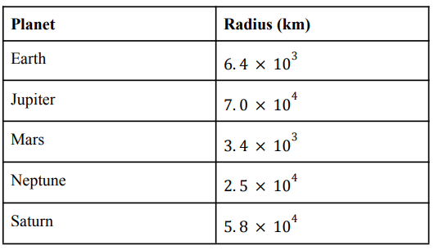
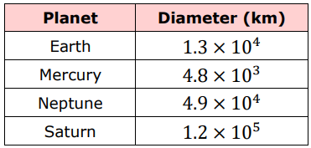
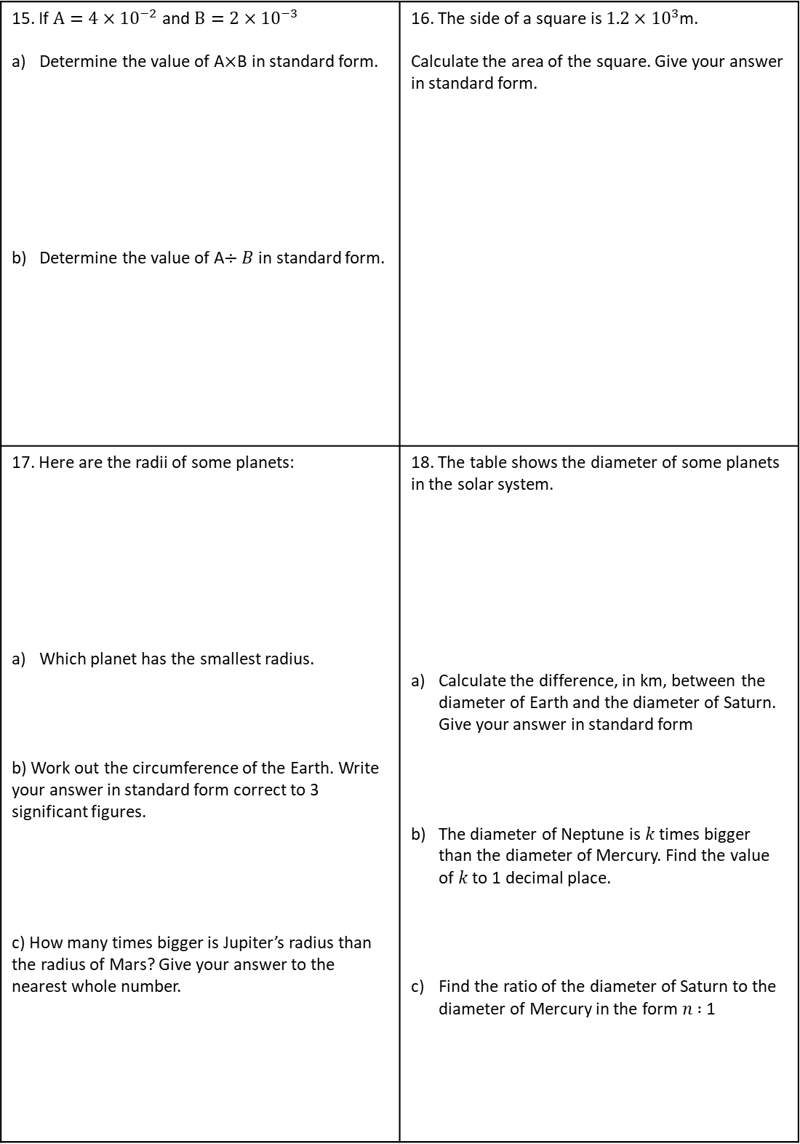
15. If $A=4×{10}^{−2}$ and $B=2×{10}^{−3}$ Determine the value of A$×$B in standard form. Determine the value of A$÷B$ in standard form. | 16. The side of a square is $1.2×{10}^{3}$m. Calculate the area of the square. Give your answer in standard form.
17. Here are the radii of some planets: Which planet has the smallest radius. b) Work out the circumference of the Earth. Write your answer in standard form correct to 3 significant figures. c) How many times bigger is Jupiter’s radius than the radius of Mars? Give your answer to the nearest whole number. | 18. The table shows the diameter of some planets in the solar system. Calculate the difference, in km, between the diameter of Earth and the diameter of Saturn. Give your answer in standard form The diameter of Neptune is 𝑘 times bigger than the diameter of Mercury. Find the value of 𝑘 to 1 decimal place. Find the ratio of the diameter of Saturn to the diameter of Mercury in the form 𝑛 ∶ 1

Slide 25
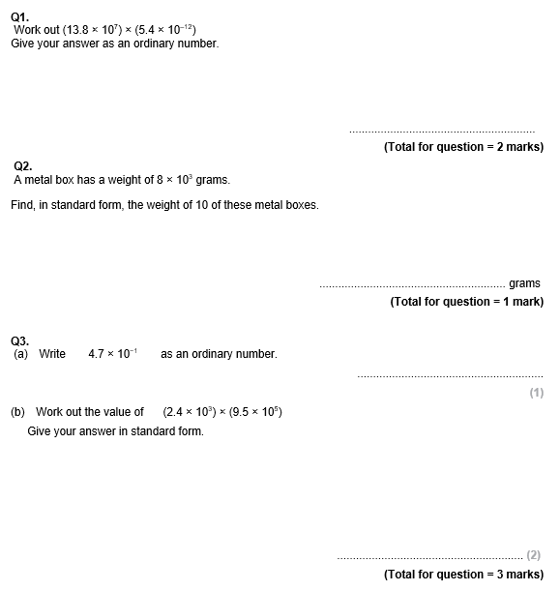
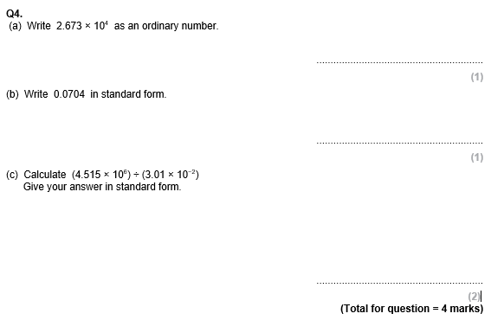
GCSE Past Paper Questions

Slide 26
